Slide 1

Alabama Veterans Museum
Presented By John Michael Raimondi and Ben Ward
Final Presentation

Slide 2
Project History & Challenges
Current database – Microsoft Access
Fragmentation – 6 files
Public UI has inactive edit controls
Public UI has a cluttered, confusing interface
In the case of multiple results - alphabetically first name loads
Small forward and backward arrows along the status bar

Slide 3
Solutions
SQL – No save file selection
Separate viewer and editor into two applications
Cleaner, more intuitive interface
In the case of multiple results, list the results for user selection

Slide 4
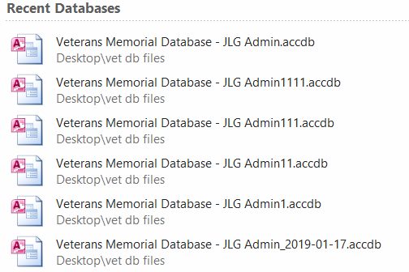
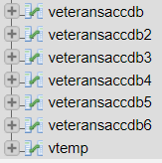
Access to SQL - Migration

Slide 5
Access to SQL - Merging
2490 - 3176 Records across db files
4199 on first merge attempt
Possible 1023 additional records over largest file?

Slide 6
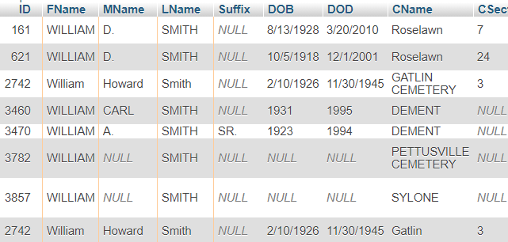
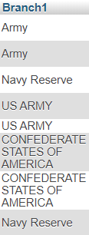
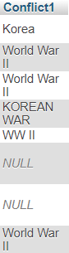
Access to SQL - Checking the Data

Slide 7
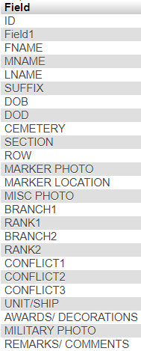
Access to SQL - Checking the Data - Columns
24 total fields (+ 1 accidental)
Look for Data fields containing possible non-unique duplicates
Cemetery, Branches, Ranks, Conflicts, and Awards (9 fields) needing updates

Slide 8
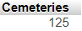
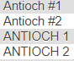
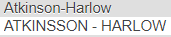
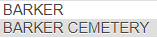
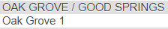
Access to SQL - Checking the Data - Cemeteries
125 unique entries
Nicknames
Same cemetery or different?

Slide 9
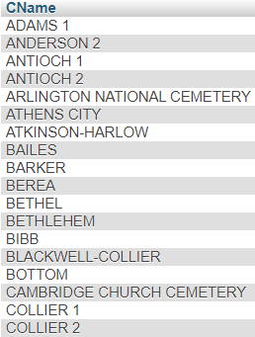
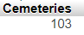
Access to SQL - Updating the Data - Cemeteries
125 to 103
# symbol removed
Spaces removed

Slide 10
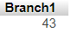
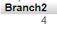
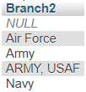
Access to SQL - Checking the Data - Branches
43 Branch1
4 Branch2
Abbreviations / full length

Slide 11
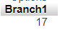
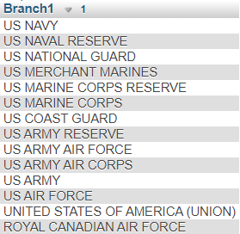
Access to SQL - Updating the Data - Branches
43 to 17 Branches
Branch2 updated as well
No abbreviations
Combined entries split later

Slide 12
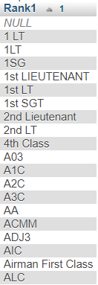
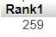
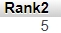
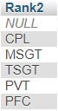
Access to SQL - Checking the Data - Ranks
259 Rank1
5 Rank2
Abbreviations
Spaces
Different characters/misspellings
Navy specializations

Slide 13
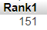
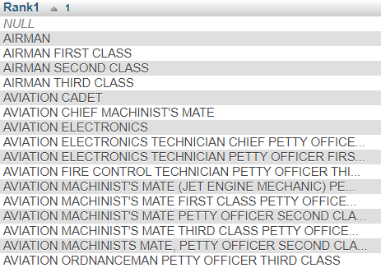
Access to SQL - Updating the Data - Ranks
259 to 151 Rank1
Rank2 updated as well
No abbreviations

Slide 14
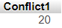
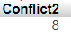
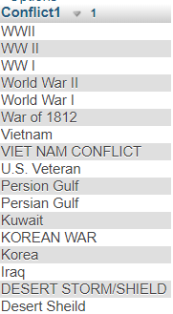
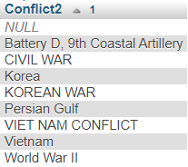
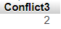
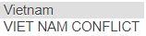
Access to SQL - Checking the Data - Conflicts
20 Conflict1
8 Conflict2
2 Conflict 3
Abbreviations
Misspellings
Accidental entry

Slide 15
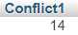
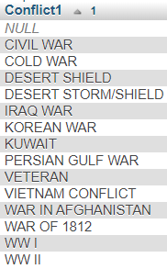
Access to SQL - Updating the Data - Conflicts
20 to 14 Conflicts

Slide 16
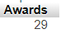
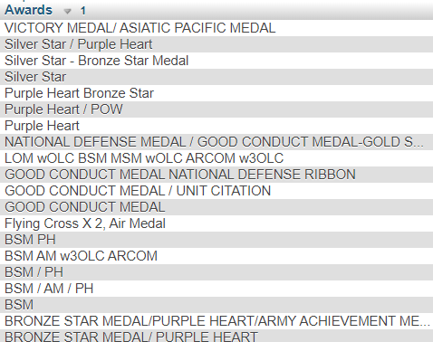
Access to SQL - Checking the Data - Awards
29 “unique” entries
Most are actually multiple awards for same veteran
Abbreviations
“With Oak Leaf Cluster”

Slide 17
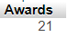
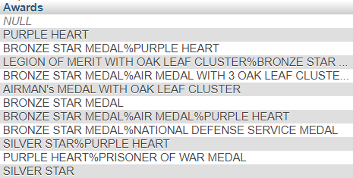
Access to SQL - Updating the Data - Awards
29 to 21 “unique” entries
Abbreviations removed
% symbol between additional awards
Fine for temp table
Wrote tool to split into permanent table

Slide 18
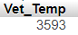
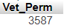
Access to SQL - Final Merge
4199 down to 3593 entries in final temporary merge table
ID’s were not taken this time
3587 entries in final permanent table
6 entries lost due to being incomplete, with no last name
411 additional entries over largest original

Slide 19
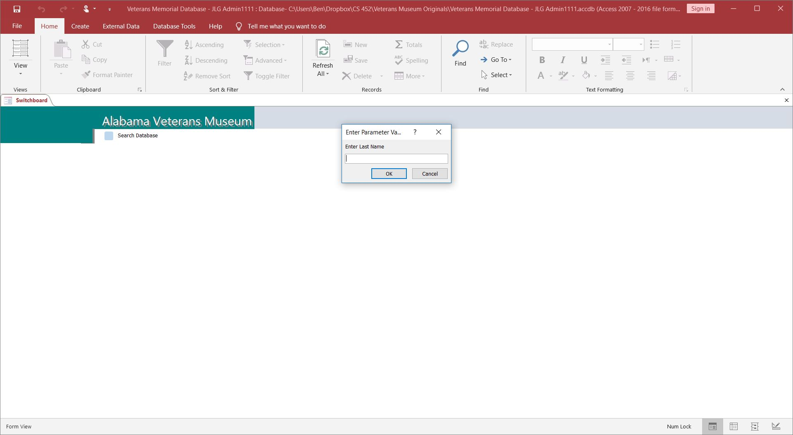
Original Access Search Interface

Slide 20
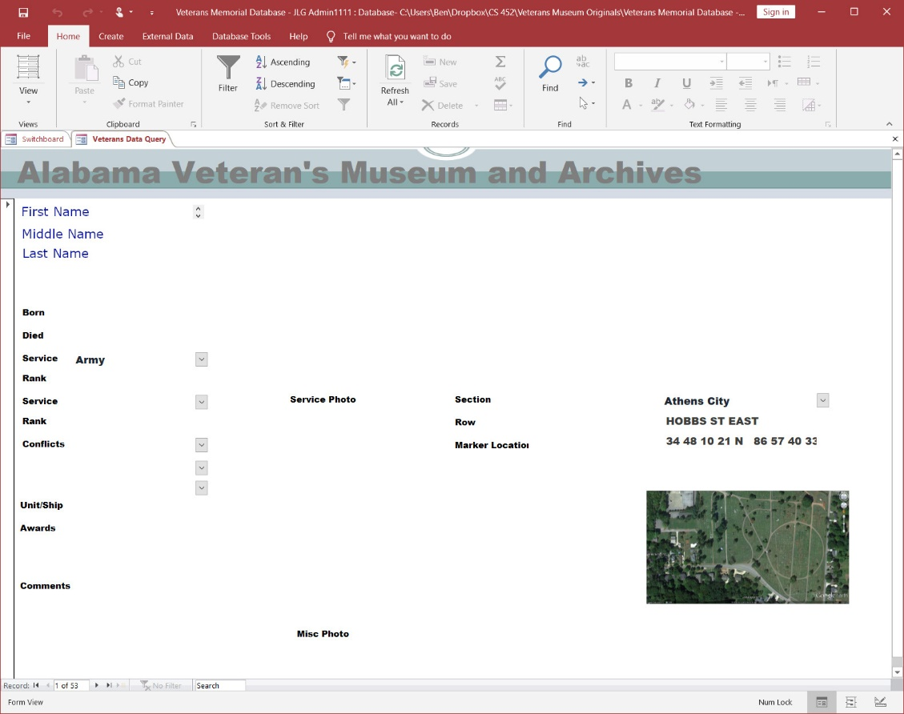
Sample Access Record Result
Note: I modified the first, middle, and last names to anonymize this record.

Slide 21
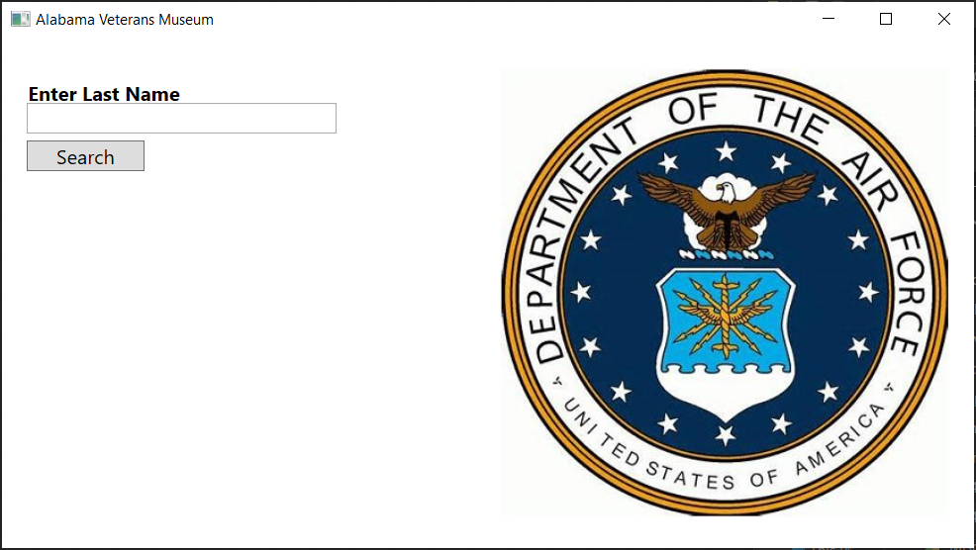
Viewer Application - Search Window

Slide 22
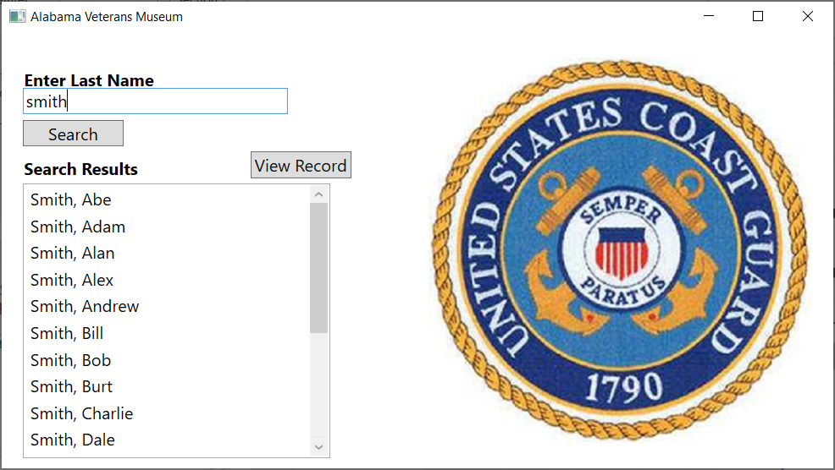
Viewer Application - Search Window

Slide 23
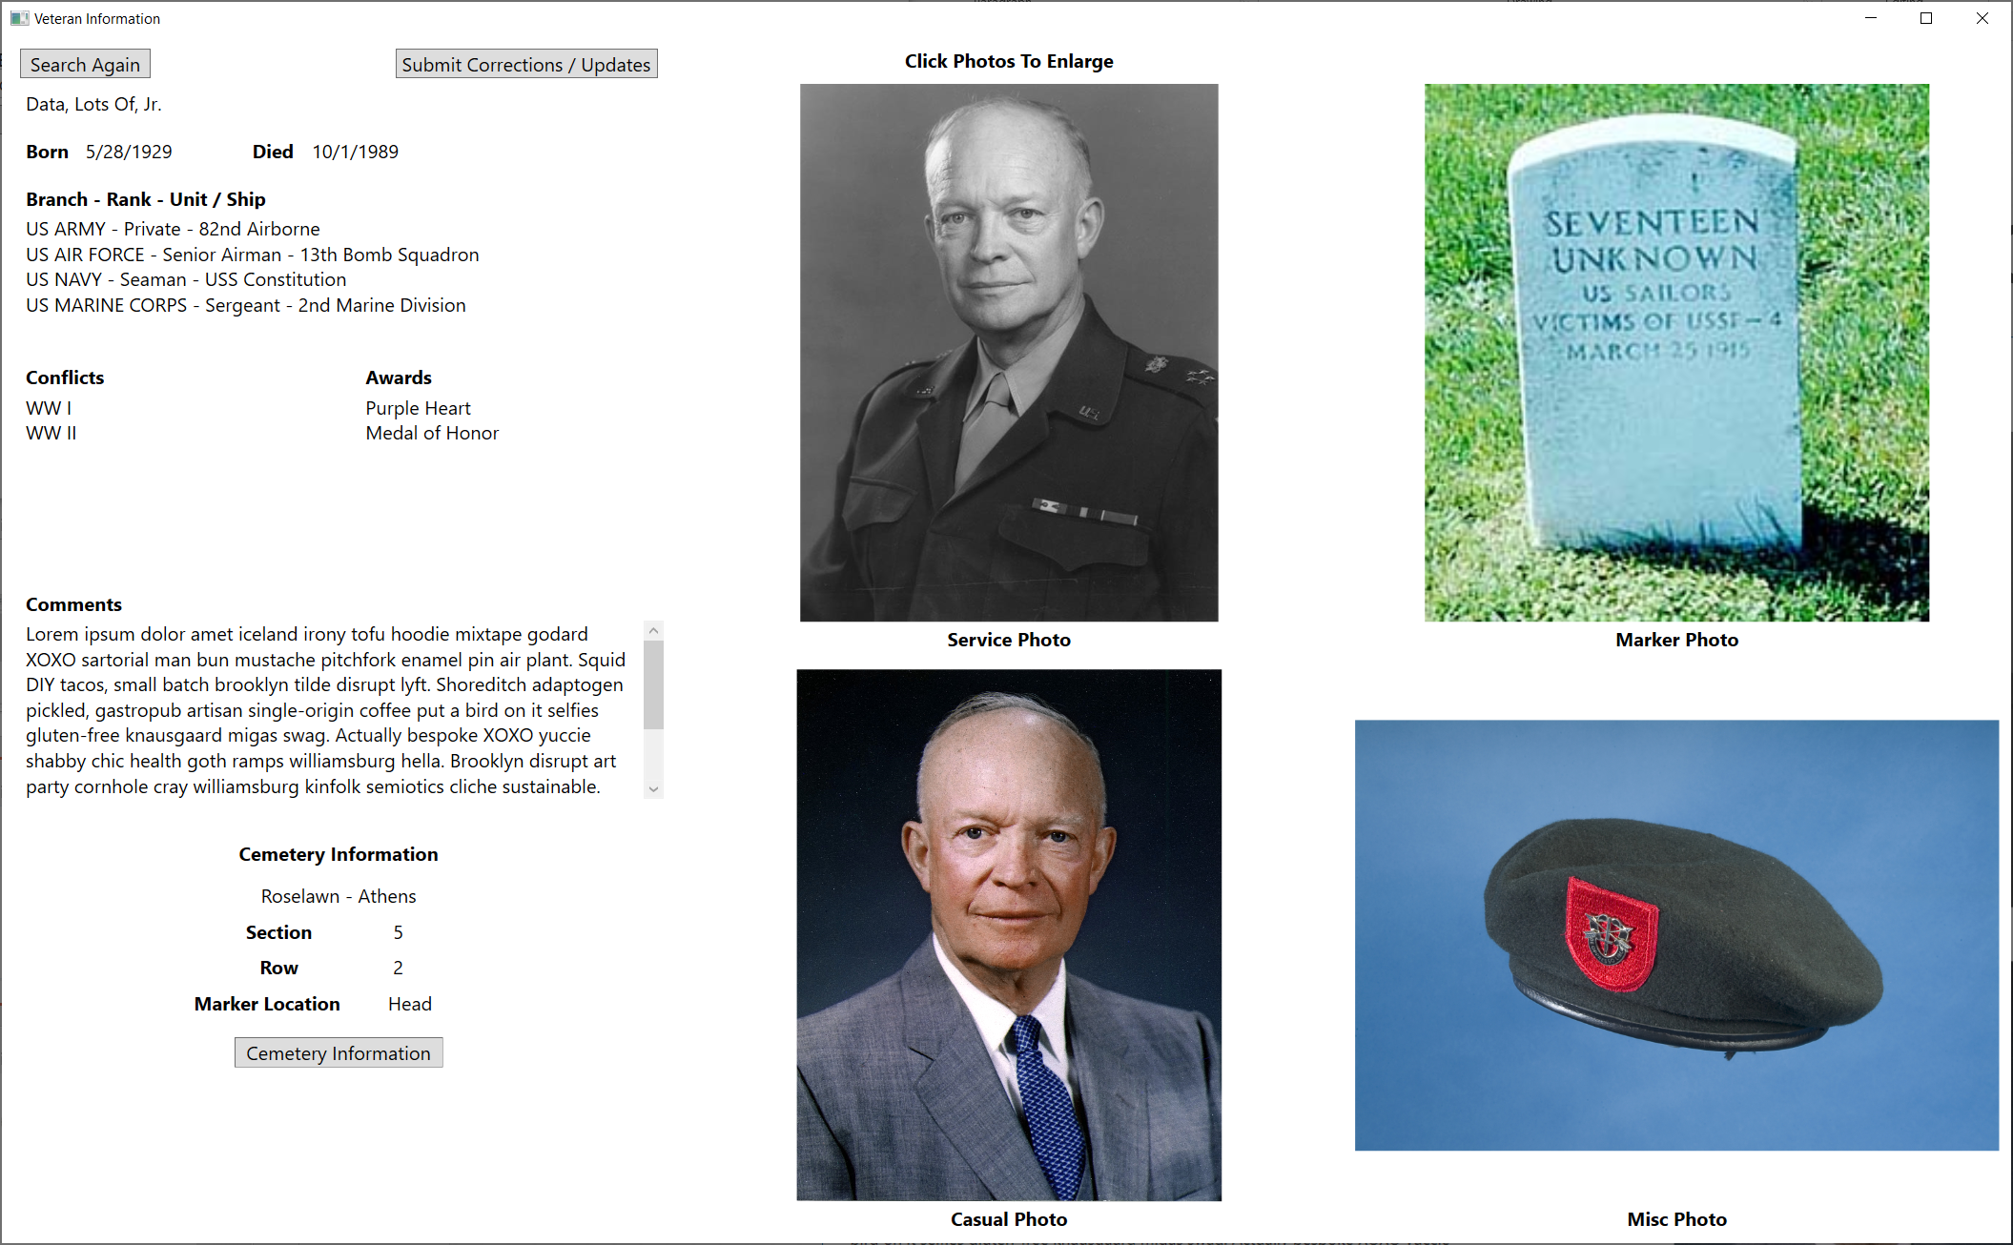
Viewer Application - Record Window

Slide 24
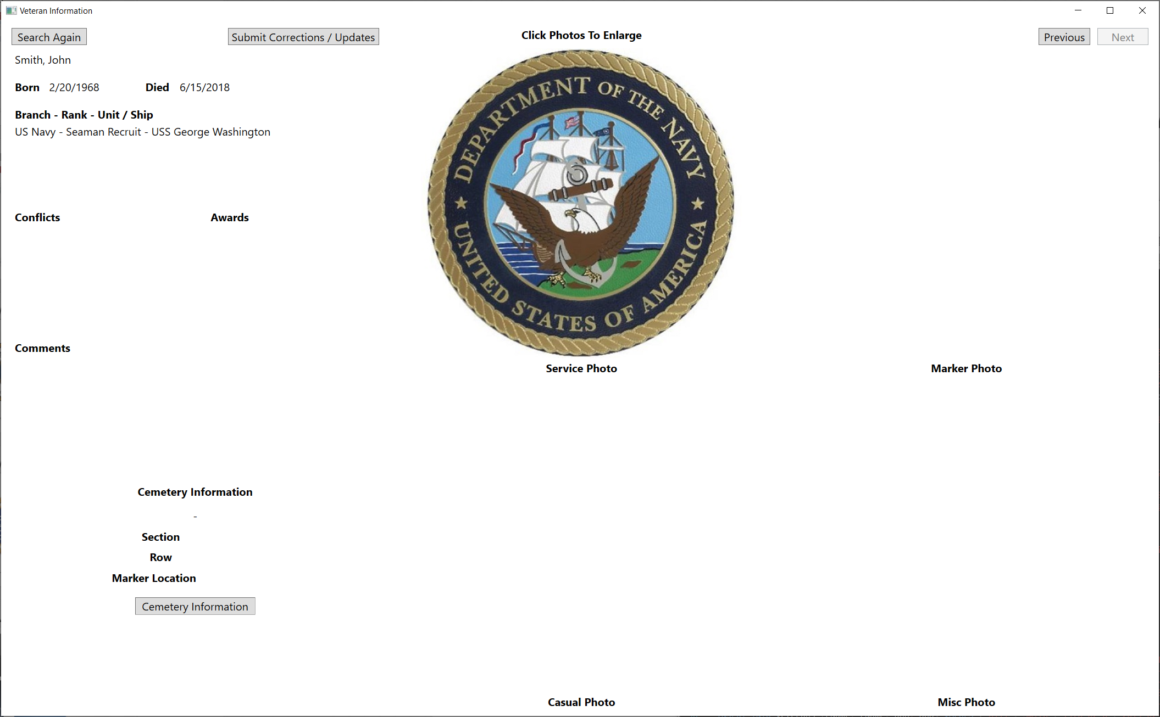
Viewer Application - Record Window

Slide 25
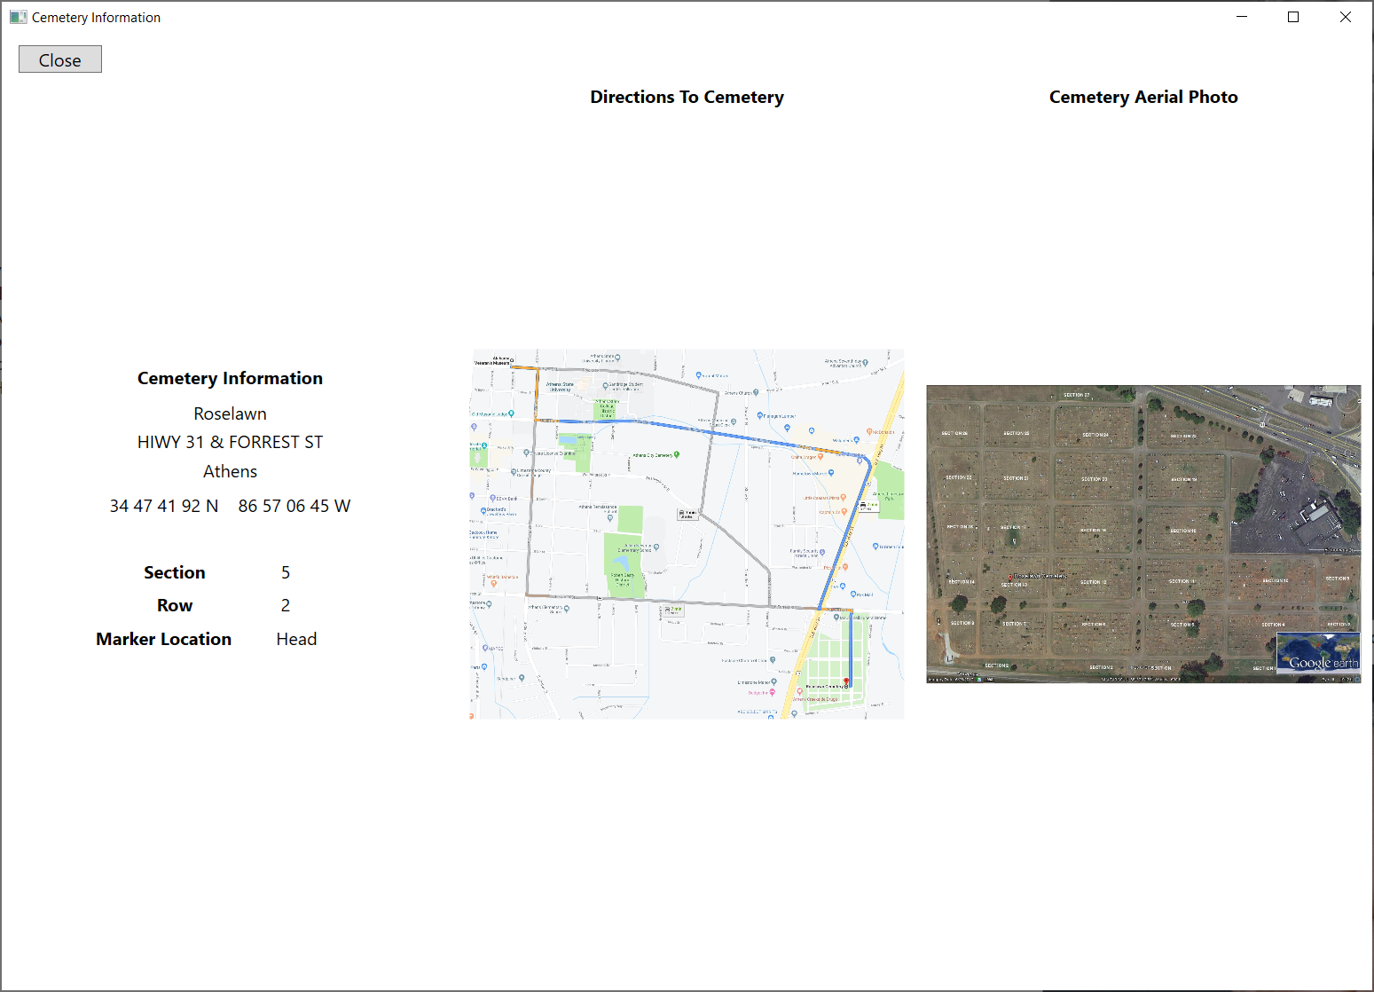
Viewer Application - Cemetery Info Window

Slide 26
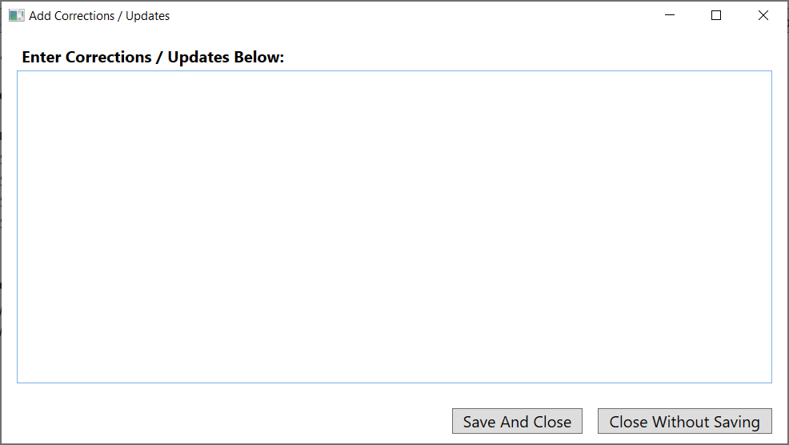
Viewer Application - User Comments Window

Slide 27
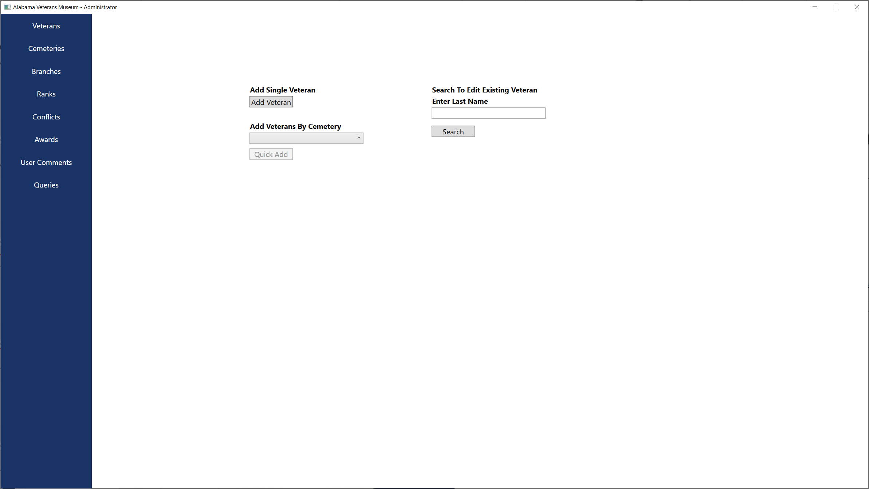
Admin Application - Veterans Window

Slide 28
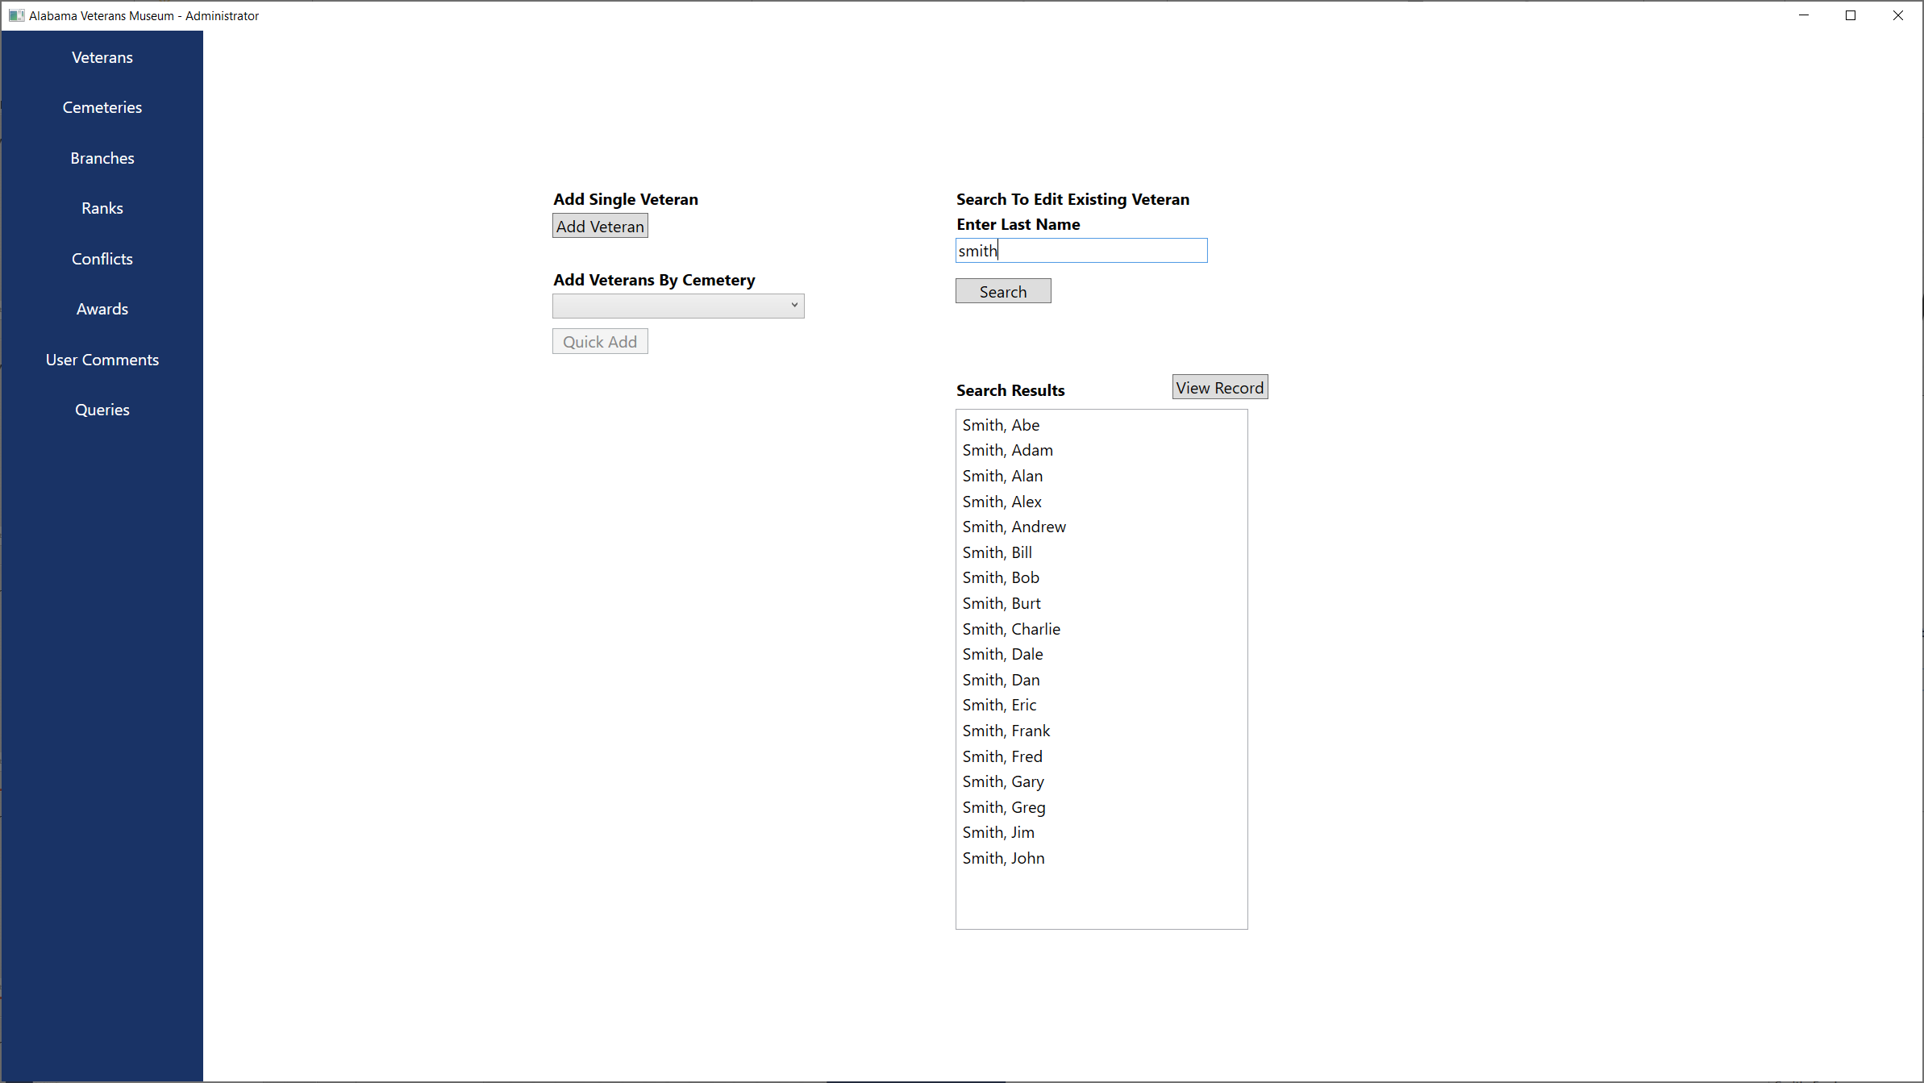
Admin Application - Veterans Window

Slide 29
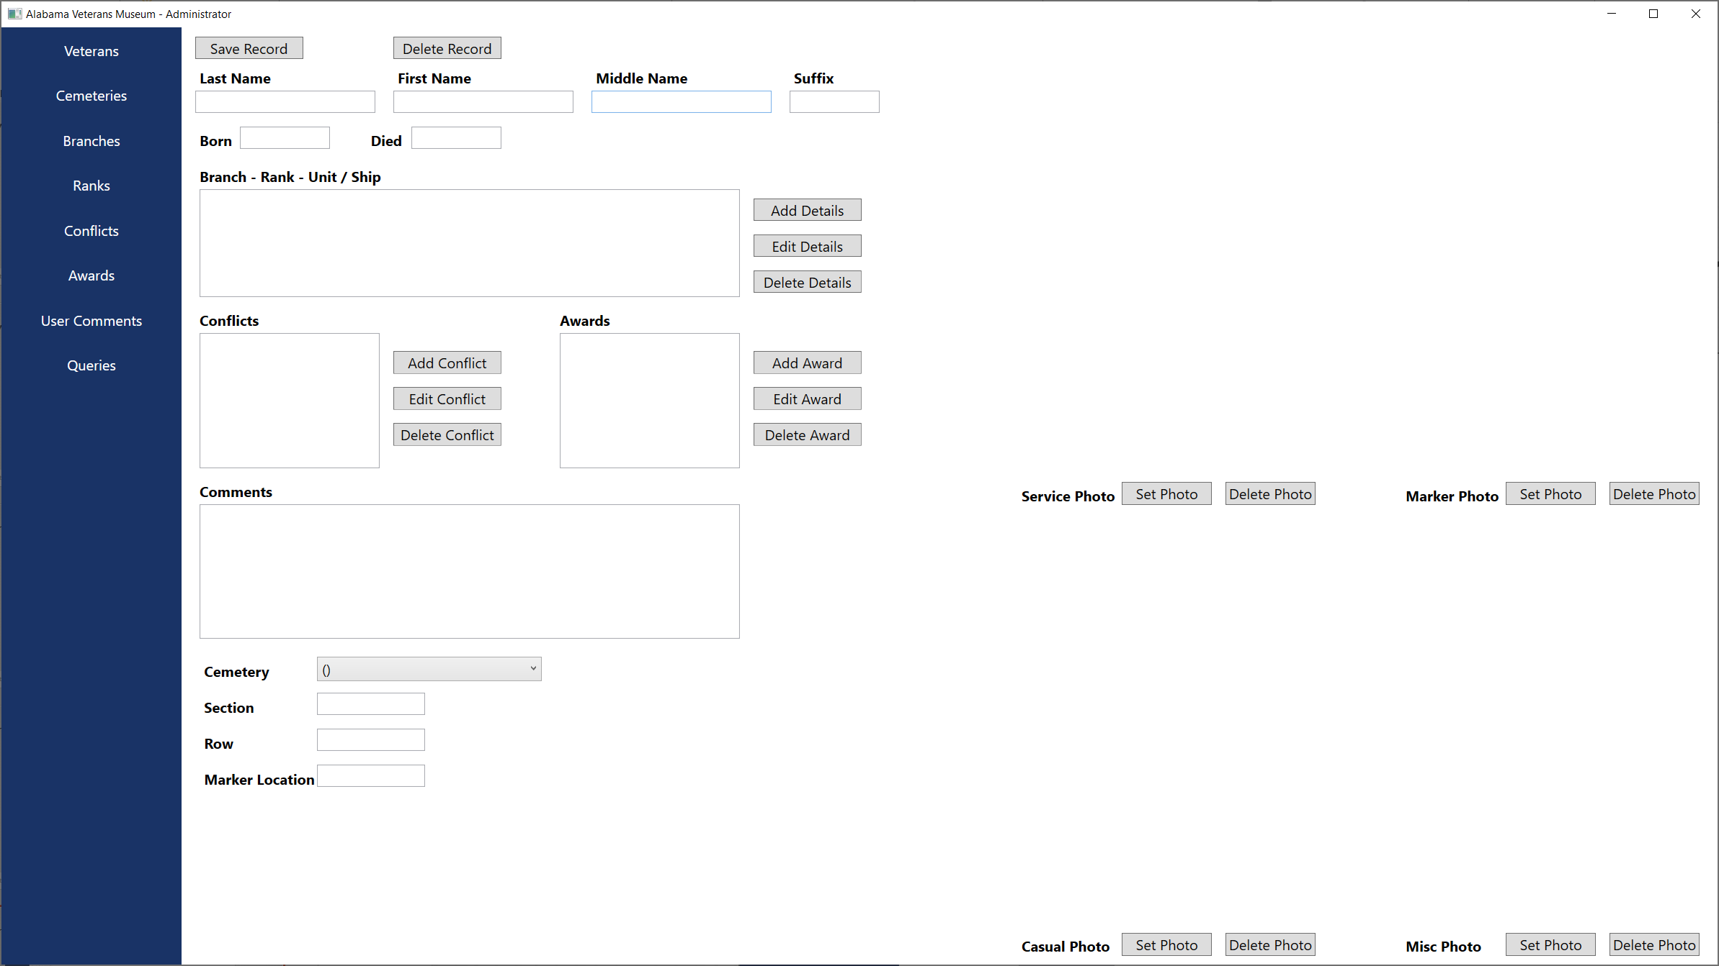
Admin Application - New Veteran

Slide 30
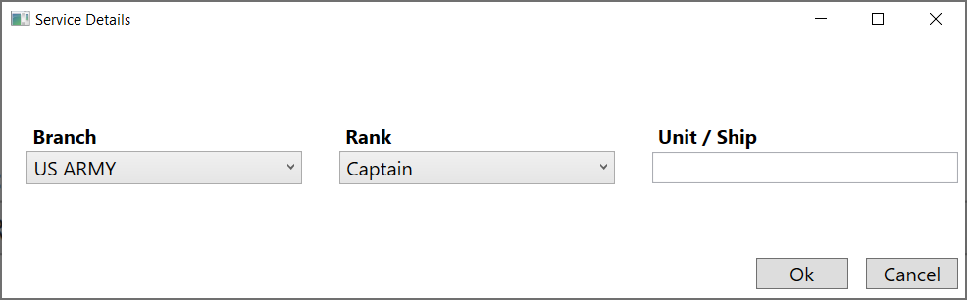
Admin Application - Service Details

Slide 31

Admin Application - Conflict Details

Slide 32

Admin Application - Award Details

Slide 33

Admin Application - Edit Veteran

Slide 34

Admin Application - Add Veteran By Cemetery

Slide 35

Admin Application - Cemeteries Window

Slide 36

Admin Application - Add Cemetery

Slide 37

Admin Application - Edit Cemetery

Slide 38

Admin Application - Delete Cemetery

Slide 39

Admin Application - Branches Window

Slide 40

Admin Application - Add Branch

Slide 41

Admin Application - Edit Branch

Slide 42

Admin Application - Delete Branch

Slide 43

Admin Application - Ranks Window

Slide 44

Admin Application - Add Rank

Slide 45

Admin Application - Edit Rank

Slide 46

Admin Application - Delete Rank

Slide 47

Admin Application - Conflicts Window

Slide 48

Admin Application - Add Conflict

Slide 49

Admin Application - Edit Conflict

Slide 50

Admin Application - Delete Conflict

Slide 51

Admin Application - Awards Window

Slide 52

Admin Application - Add Award

Slide 53

Admin Application - Edit Award

Slide 54

Admin Application - Delete Award

Slide 55

Admin Application - User Comments

Slide 56

Admin Application - View Comments

Slide 57

Admin Application - Queries

Slide 58

Admin Application - Sample Query (How Many)

Slide 59

Admin Application - Sample Query (List The)

Slide 60

THANK YOU FOR YOUR TIME

